Slide 1
Detecting Hate Speech
Capstone project by Derek Powell

Slide 2

Cyber-bully, intimidation, abusive language…it goes by many names, and it can cost companies money when it pervades their digital communications platforms.

Slide 3
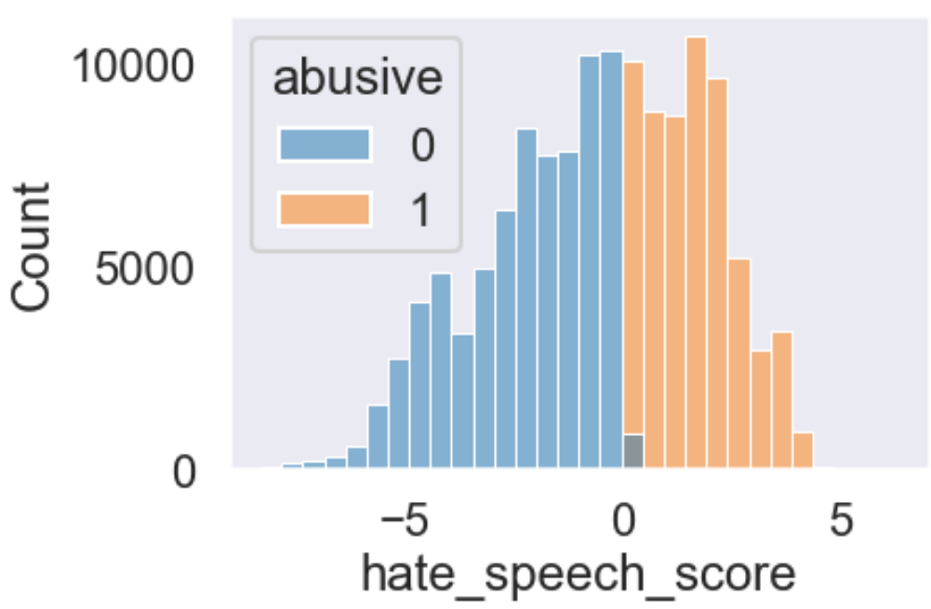
Over 40% of Twitter posts are considered ‘abusive’ in some way, as labeled by a volunteer team of annotators in an independent study.
Notes:
In a dataset containing 135,000 tweets from Twitter, independently annotated, we see that nearly half of them are labeled as ‘abusive’.

Slide 4
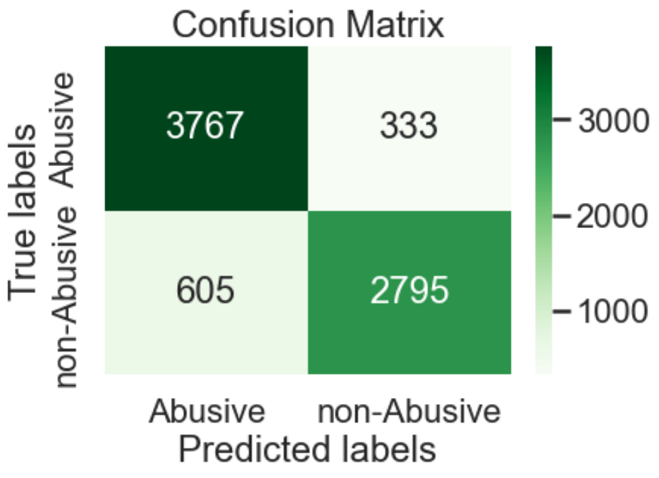
By leveraging machine learning, we can build a model that can evaluate text input and classify abusive text correctly 92% of the time
Notes:
Random Forest model with 300 Estimators

Slide 5

By limiting cyber bulling and other forms of abusive communication, companies can nurture and grow user engagement.

